Slide 1
Erosion and Deposition
Review RiverDeposition
Introduce New forms of Deposition:
Waves
Glaciers
MassMovement

Slide 2
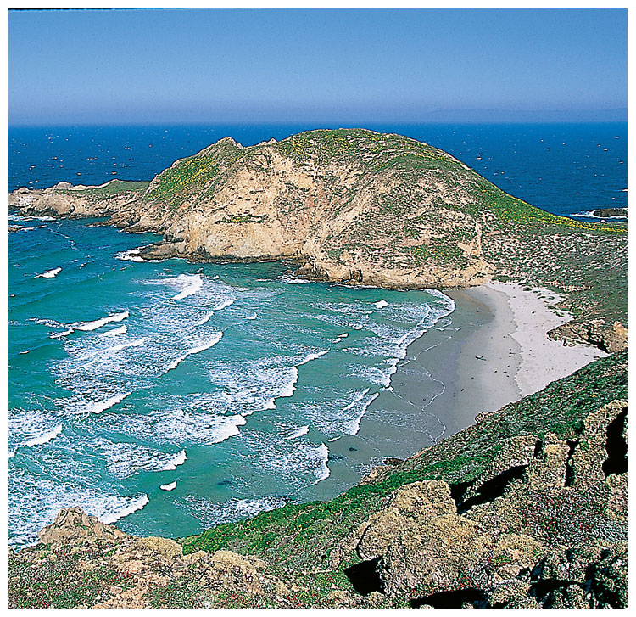
Wave Erosion
Waves continuously break rock into smaller pieces.
Landforms created:
  Beaches
  Cliffs
  Sea stacks

Slide 3
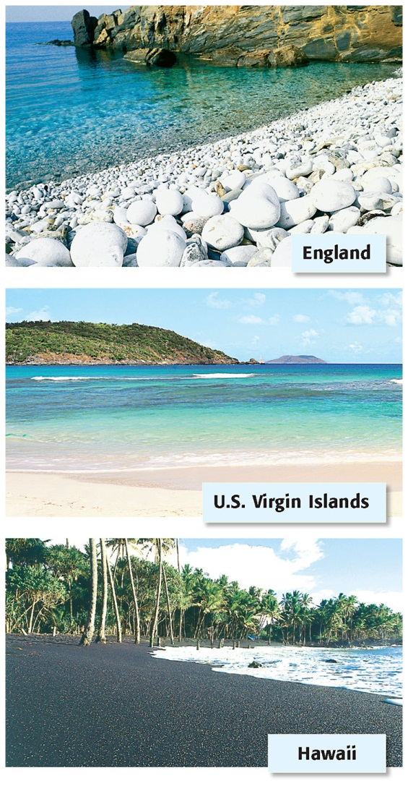
Wave Deposition
Waves carry sand, rock fragments, and shells.
This gets deposited on a shoreline .
This creates a beach.
Longshore currents moves parallel to a shoreline, moving sediment in a zig-zag pattern

Slide 4
3 Types of Wave Deposition
A sandbar is an underwater or exposed
ridge of sand, gravel, or shell material.
A barrier spit is an exposed sandbar that is
connected to the shoreline. Cape Cod,
MA is an example of a barrier spit.
A barrier island is a long, narrow island usually
made of sand that forms offshore parallel to t
he shoreline

Slide 5
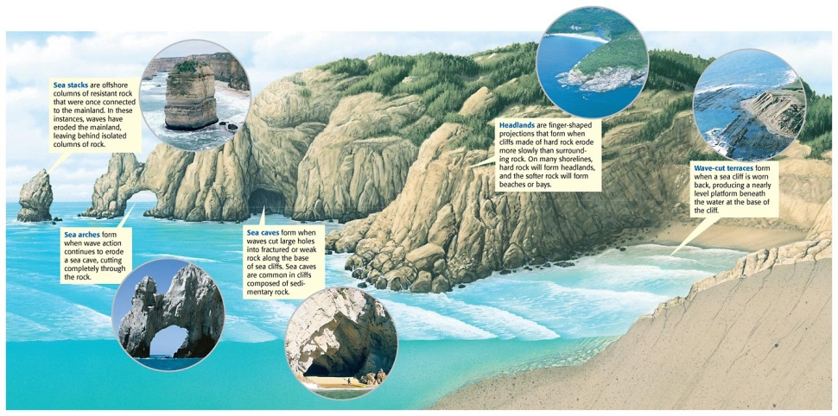
Wave Erosion

Slide 6
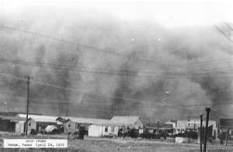
Wind Erosion
Wind moves sediment.
Plant roots hold soil in place
  Less vegetation, more erosion
  Dust Bowl happened this way

Slide 7
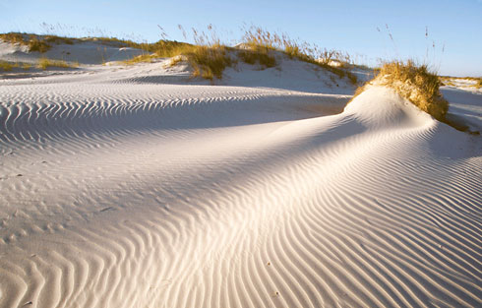
Wind Deposition
Wind eventually drops everything it carries
Faster it blows, more it carries.
When it slows, it drops what it carries
EX: Sand dunes

Slide 8
3 forms of wind erosion:
Saltation is the skipping and bouncing movement of sand-sized particles in the direction the wind is blowing.
During deflation, wind removes the top layer of fine sediment or soil and leaves behind rock fragments that are too heavy to be lifted by the wind
The grinding and wearing down of rock surfaces by other rock or sand particles is called abrasion.
Abrasion commonly happens in areas where there are strong winds, loose sand, and soft rocks

Slide 9
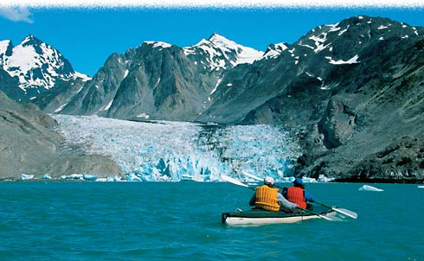
Glacier Erosion
Glaciers are rivers of moving ice
Gravity moves them
They pickup rocks and sediments as they move
Brainpop

Slide 10
Ice Deposition
As a glacier melts, it drops what it carries
Glacial drift - all material carried and deposited by glaciers. Glacial drift is divided into two main types, till and stratified drift.

Slide 11
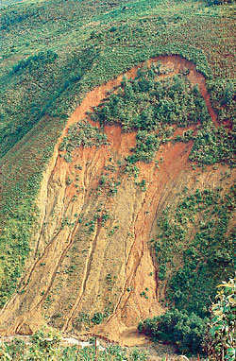
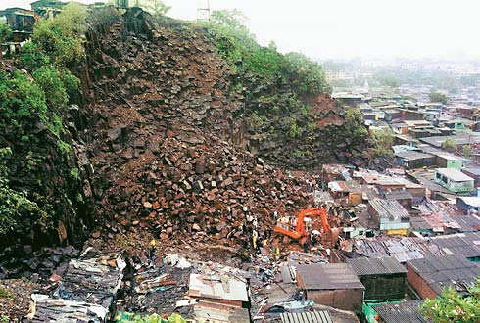
Deposition by Gravity
Mass movement of sediments downhill

Slide 12
Mass Movement
Rapid movement: landslides, rock falls, mudflows
landslide in Russia
ALPS
Rock fall in France
mudslide in British Columbia
Slow mass movement: creep

Slide 13
Brainpop Avalanches

