Slide 1
Chapter 10
Weathering and Soil Formation

Slide 2
Chap 10, Sect 2 (Rates of Weathering)
Objectives:
Explain how the composition of rock affects the rate of weathering.
Describe how a rock’s total surface area affects the rate at which the rock weathers.
Describe how differences in elevation and climate affect the rate of weathering.

Slide 3
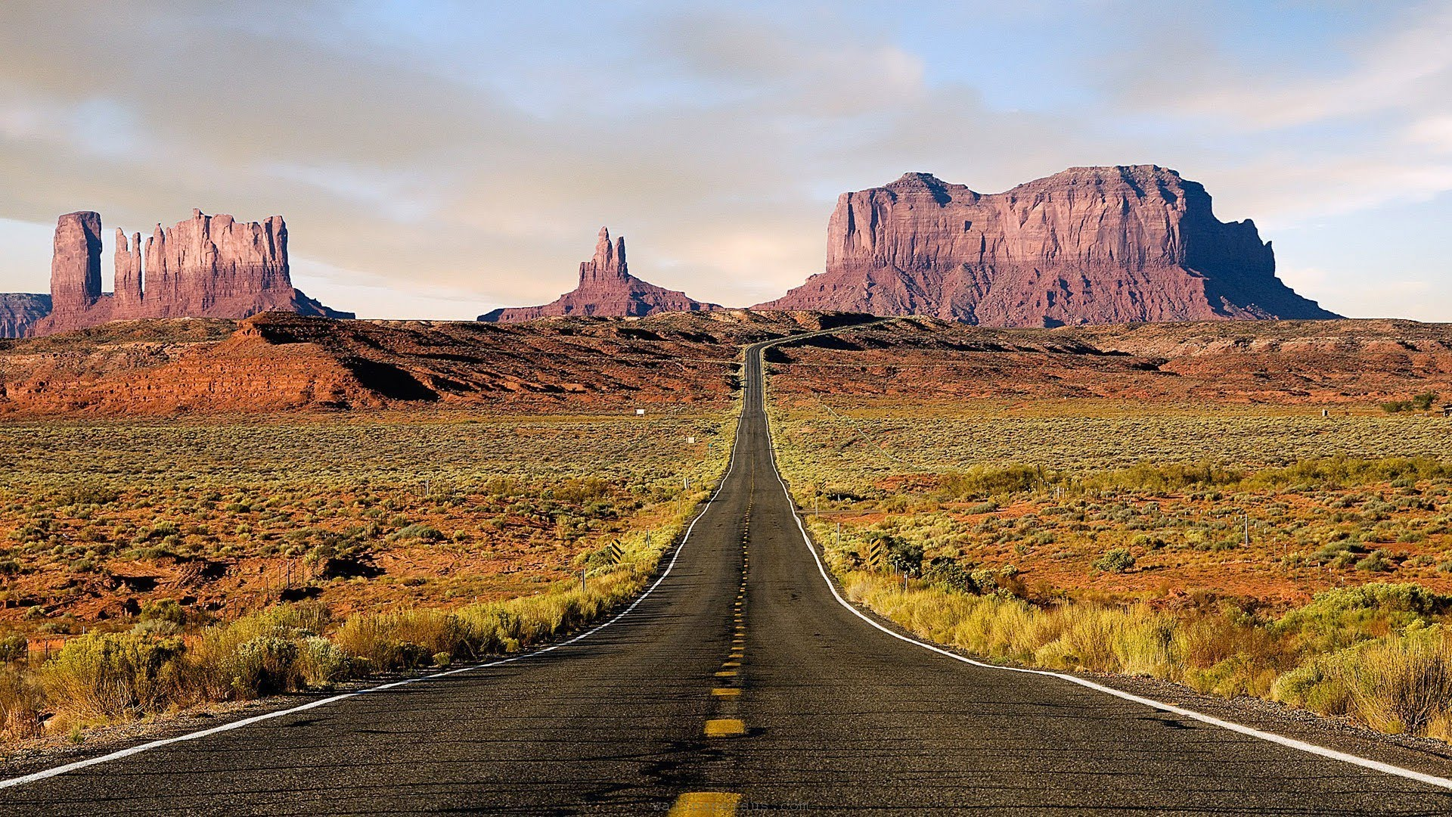
Hard rocks like granite, which is an ____________ rock, weather more S…L…O…W…L…Y… than soft rocks like sandstone, which is a ___________ rock.

Slide 4
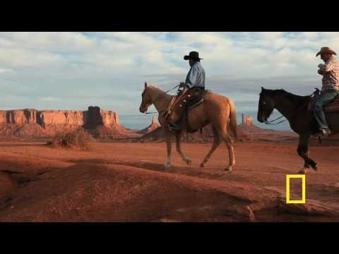

Slide 5
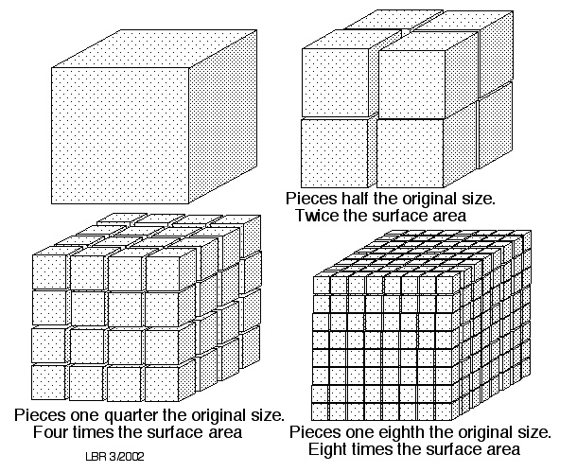
More surfaces = FASTER weathering!
Let’s count the surfaces on a sheet of white paper. Now, let’s rip it….how many surfaces are there? How about if we rip it again? Again?

Slide 6
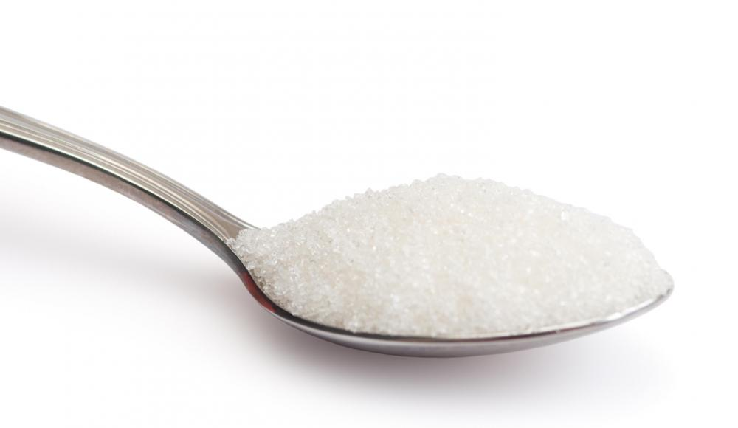
Analysis:
Did the sugar dissolve at the same rate in both containers? Explain.
Do you think one large rock or several smaller rocks would wear away faster? Explain.

Slide 7
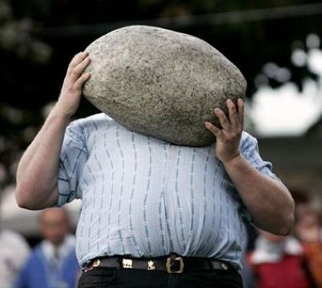
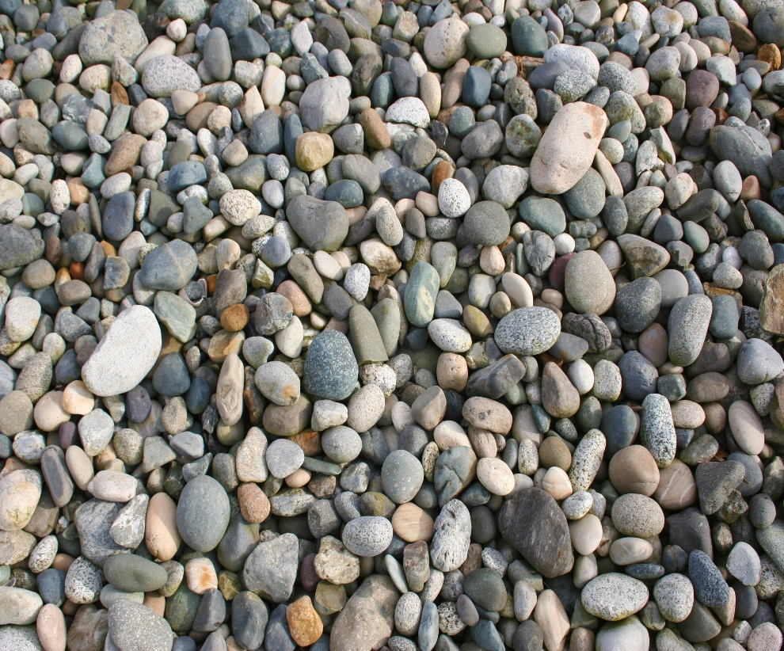
Weathering takes place on the outer surface of rocks
The more surface area (outsides) that is exposed to weathering, the faster the rock will be worn down
VS.

Slide 8
Tech Term:
Differential weathering – the process in which softer, less weather resistant rocks (sedimentary – limestone/sandstone) wear away leaving more weather resistant rocks (igneous – granite/basalt) behind.

Slide 9
Weathering & Climate
Weathering & Elevation
Higher elevations are exposed to more wind, water, and ice
Steepness of slopes causes rainwater to flow quickly, increasing the rate of mechanical and chemical weathering
Chemical weathering is faster in warm, humid climates
Water increases the rate of mechanical weathering
Varying temperatures cause freezing and thawing, thus contributing to ice wedging
They both affect the rate of mechanical & chemical weathering

