Slide 1
Ch.10, Sect.4:
Soil Conservation
Please Copy in your IAN
Objectives:
What are the 3 Benefits of Soil?
Describe/Illustrate 4 methods of preventing soil damage.
3) 10.3 Review:
Please take out the graphic organizer in your tubs and glue it in! Complete it.

Slide 2
https://www.brainpop.com/science/earthsystem/soil/

Slide 3
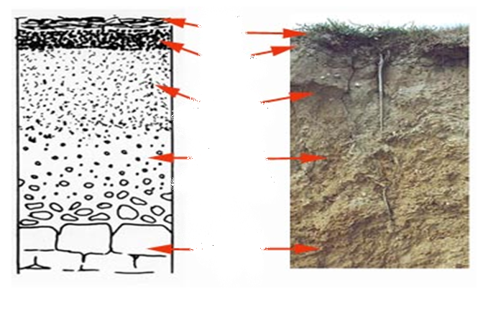
Let’s Review! Soil Horizons
litter
(O horizon)
topsoil
subsoil
weathered parent material
bedrock
(R horizon)

Slide 4
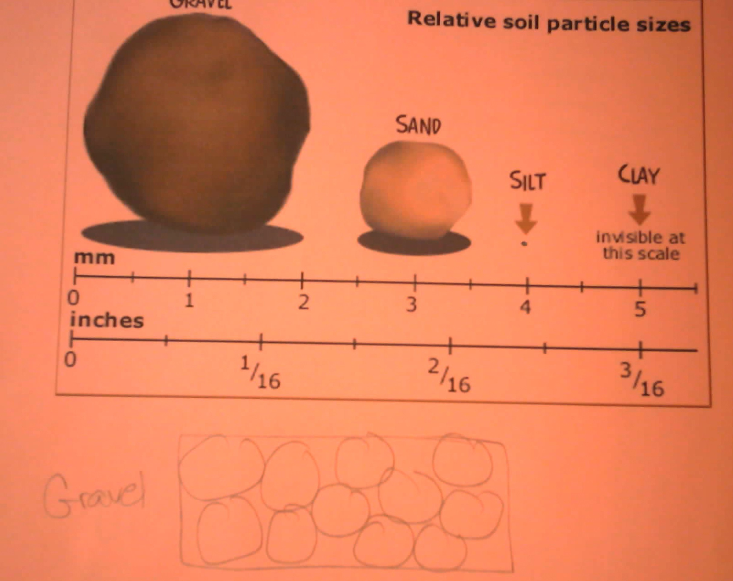

Slide 5
“The nation that destroys it’s soil destroys itself” –Franklin D. Roosevelt
Tech Term:
1) soil conservation- a method to maintain the fertility of the soil by protecting the soil from erosion and nutrient loss.
The Importance of Soil:
  Provides minerals and nutrients for plants to grow
  If plants do not get enough food, neither do animals. Why?
  Housing/Habitat
  Water Storage

Slide 6
Soil Damage and Loss:
**It takes 500 years for 2 cm of soil to form**
Soil Damage and Loss: poor farming, overgrazing
Tech Terms
  2) Land degradation- desertification, making land infertile
  3) erosion- the process when wind, water, or gravity transport soil and sediment from one location to another
  **Roots = Anchors**

Slide 7
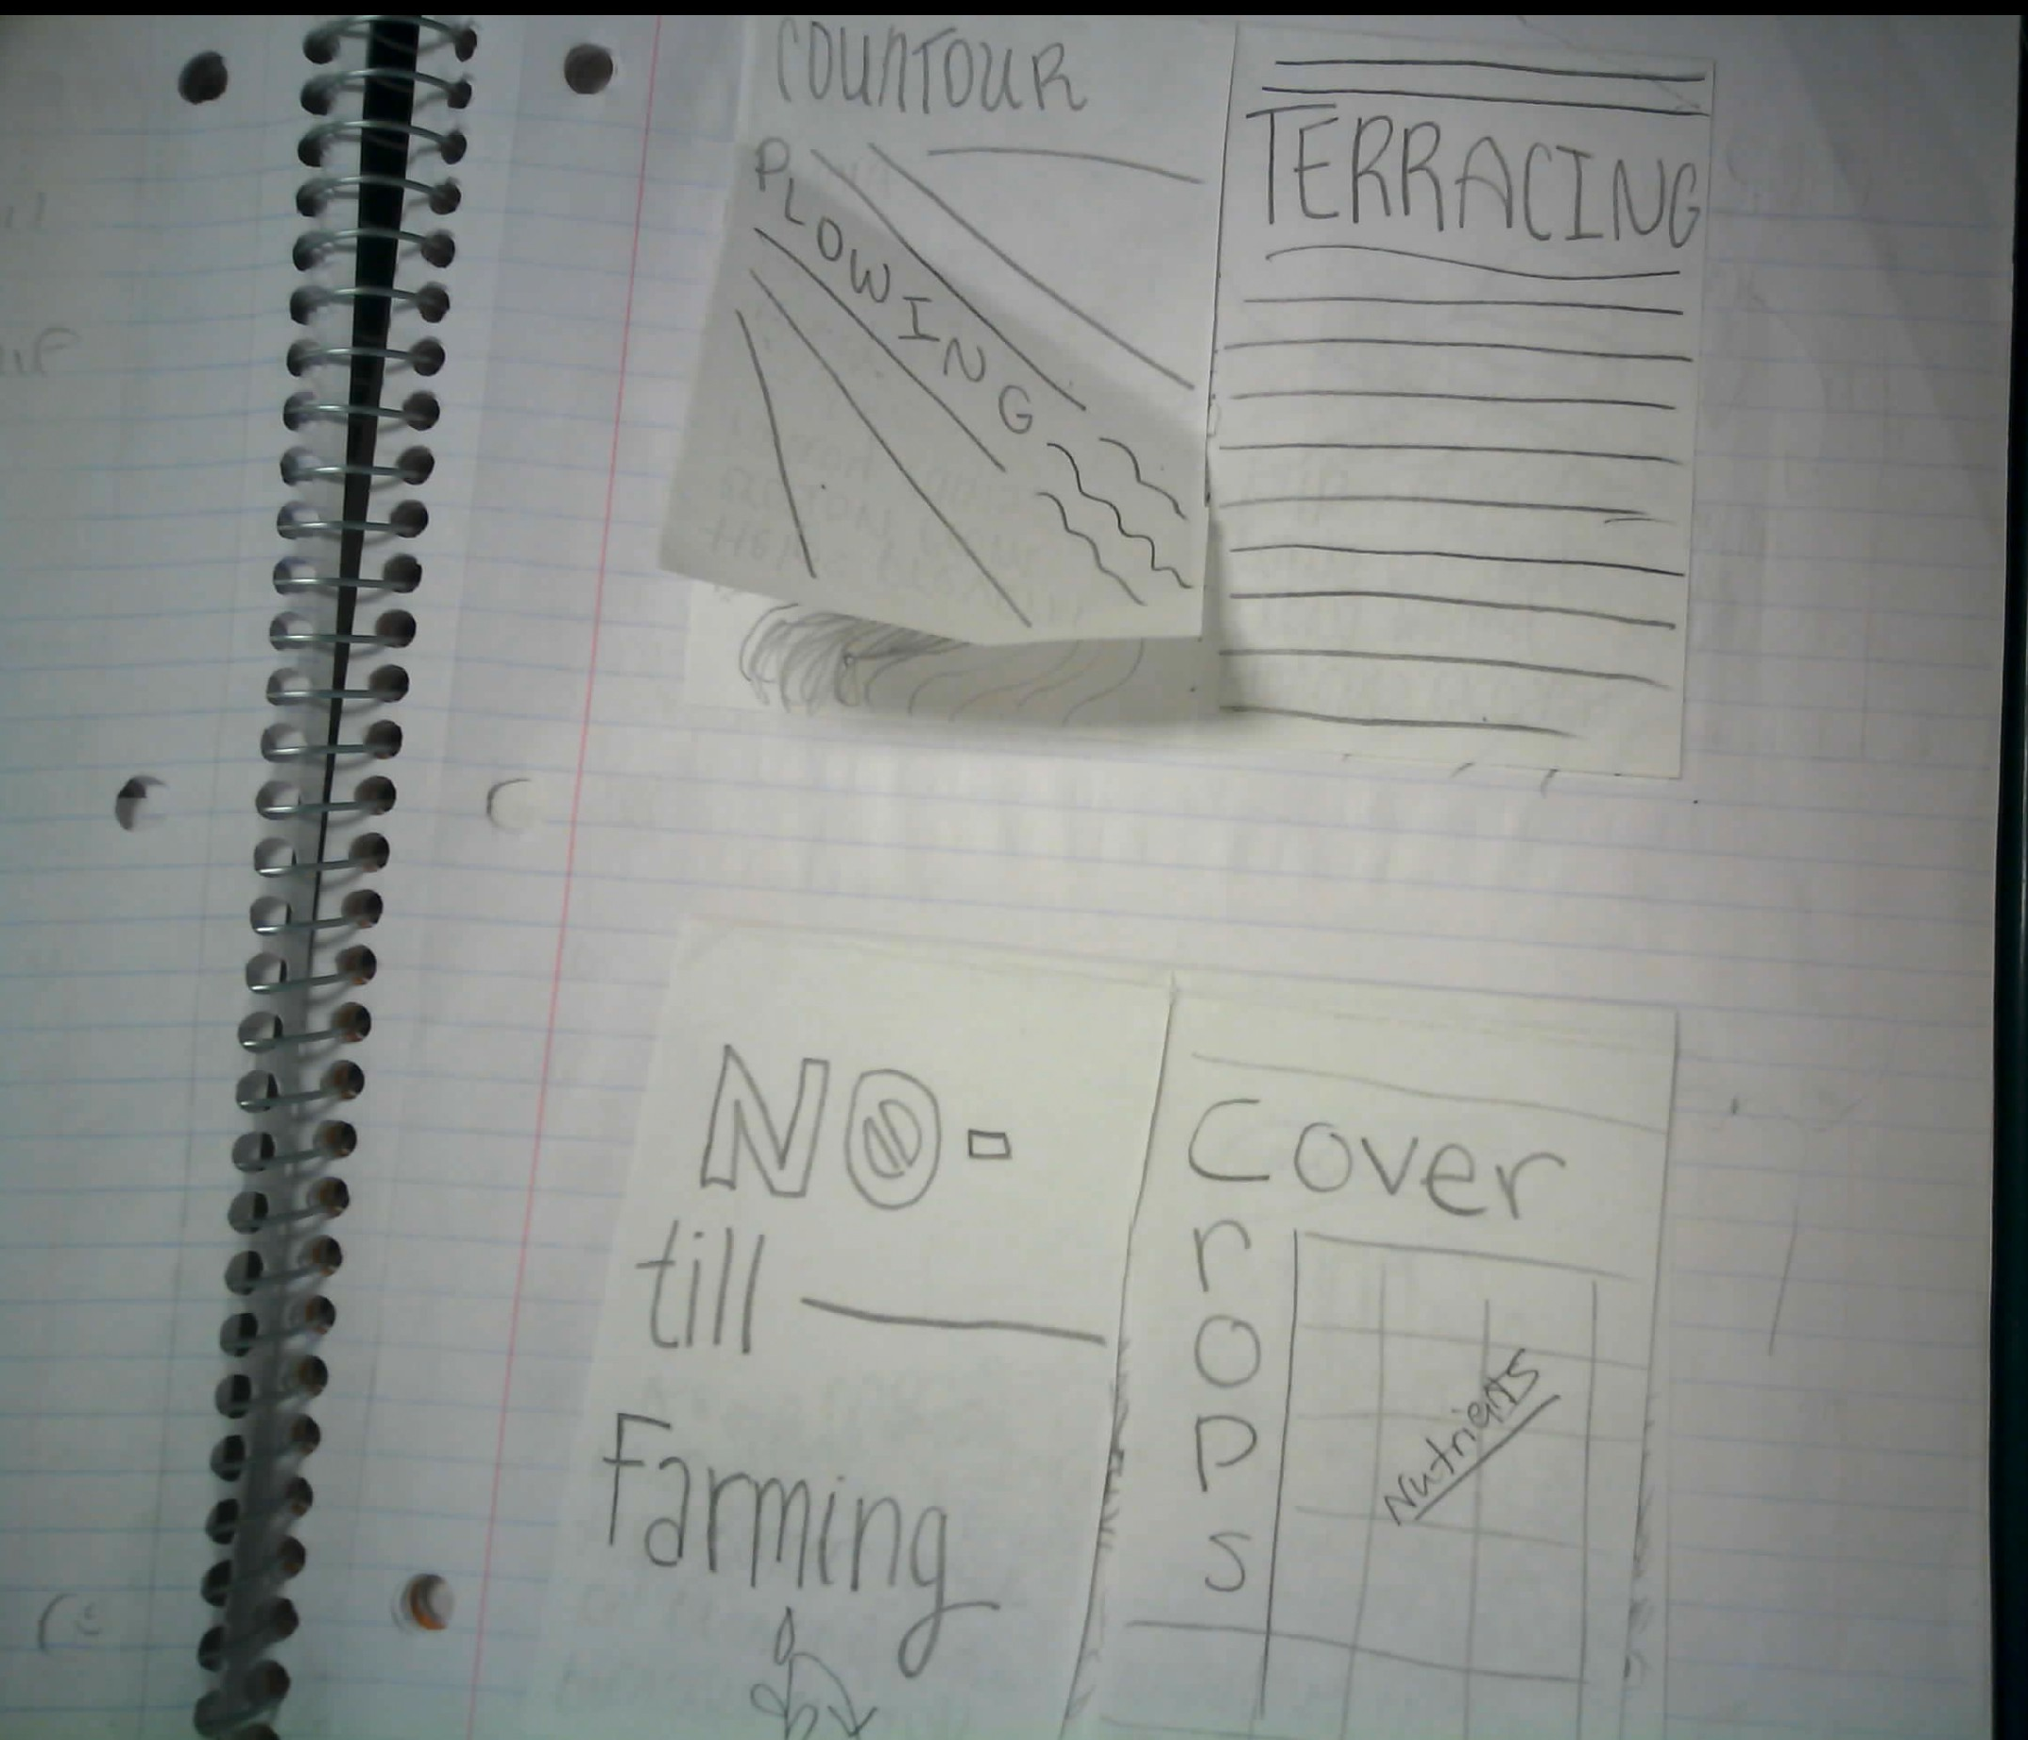
Real World
Solutions?

Slide 8
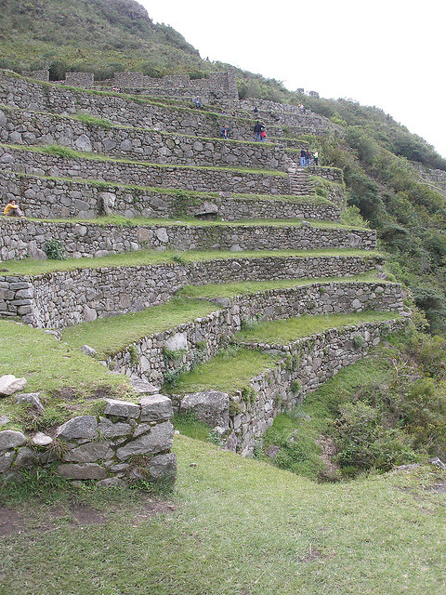
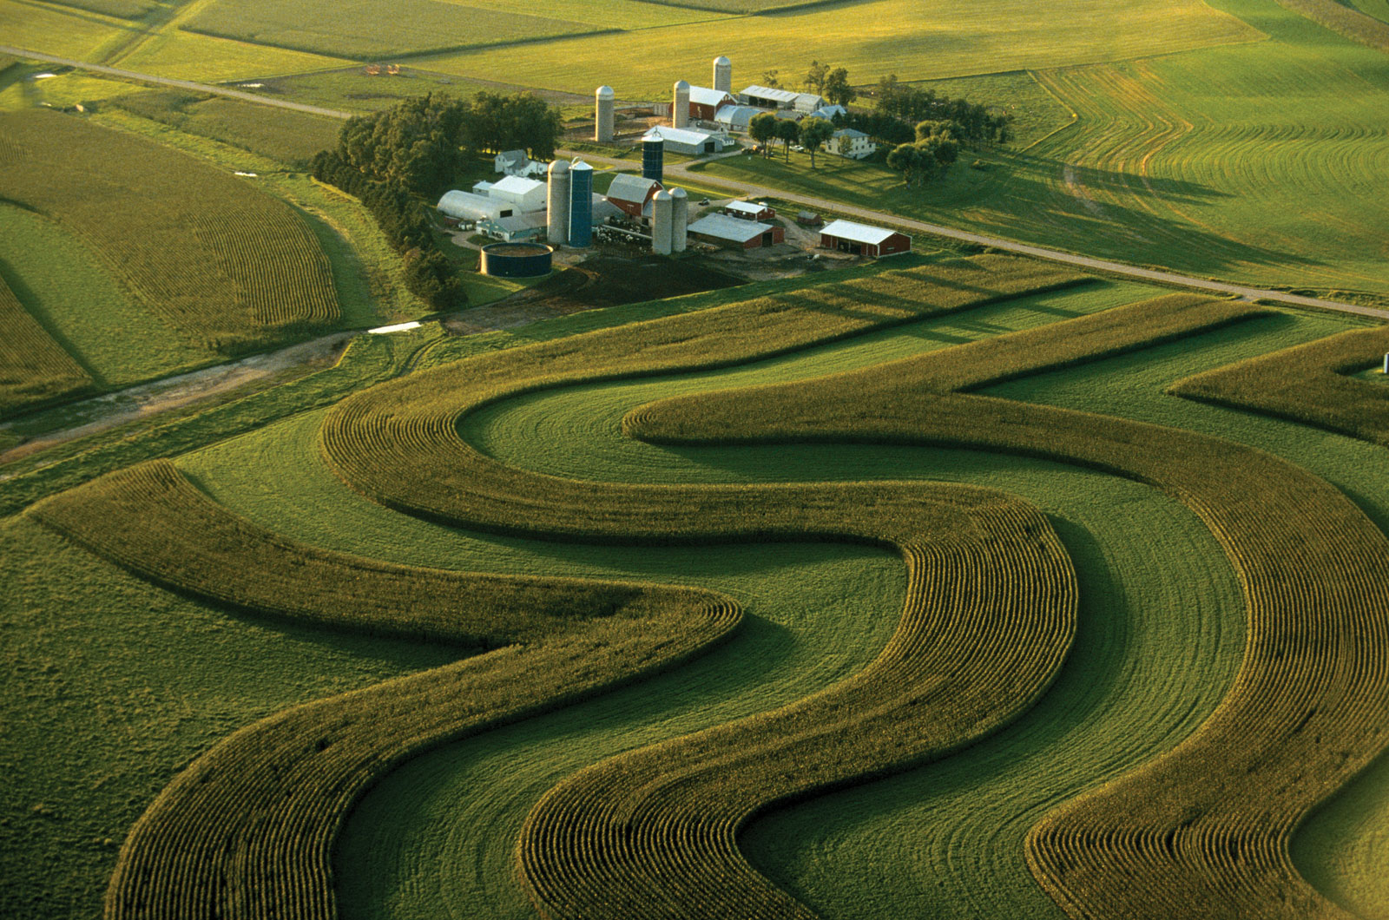
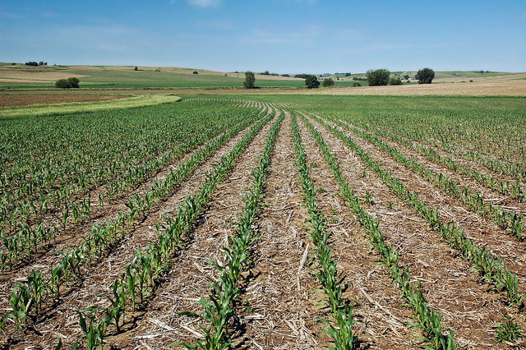
Soil Conservation Techniques
4) Contour Plowing- rows of plowing across a slope of hills to act like dams
5) Terracing – with steep hills, you make a series of smaller, flatter fields (steps)
6) no-till farming – leave old stalks behind

Slide 9
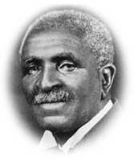
More Techniques
7) cover crops – crops planted between harvest seasons to replace nutrients and prevent erosion
  Ex. Cotton plants vs. George Washington Carver
8) Crop rotation – planting different crops from year to year

Slide 10
Section Review
How can human activity affect soil erosion?
  Positive
  negative
What are 3 benefits soil provides?
How does crop rotation benefit soil?
Has there always been soil on Earth?

