Slide 1
Chapter 11
The Flow of Fresh Water

Slide 2
Chap 11, Sec 1&2 (The Active River)
Objectives:
Describe how moving water shapes the surface of the Earth.
Explain 3 factors that affect the rate of stream erosion.
Describe a watershed.
Describe how a stream or river erodes and deposits sediment simultaneously (at the same time).

Slide 3
3Factors of Stream Erosion:
1.Gradient- the steepness of a slope
2. discharge – the amount of water that a stream or river carries in a given amount of time
3. load- the sediment that a stream carries (3 types)
A stream’s ability to erode is influenced by these three factors!

Slide 4
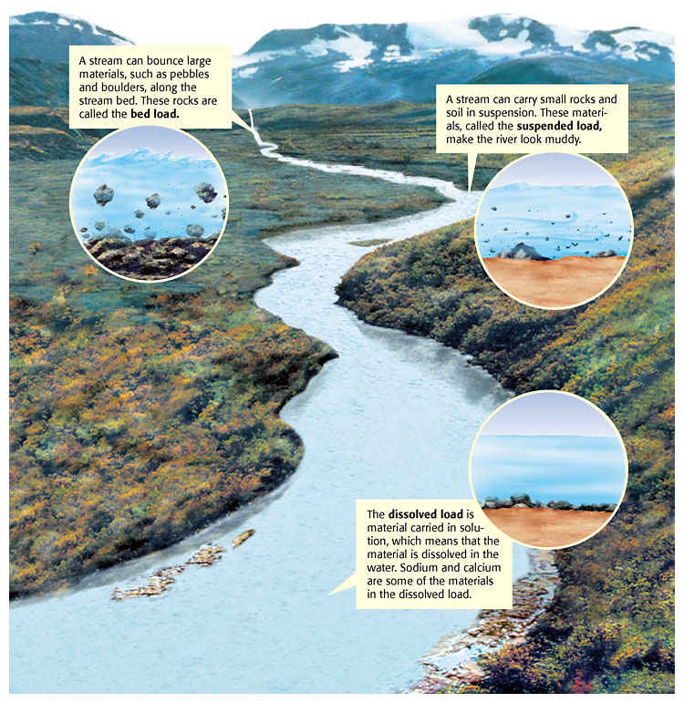

Slide 6
Why do rivers curve? (3min)
Red Dye Meandering river
(1.5 min)
hotlink

Slide 7
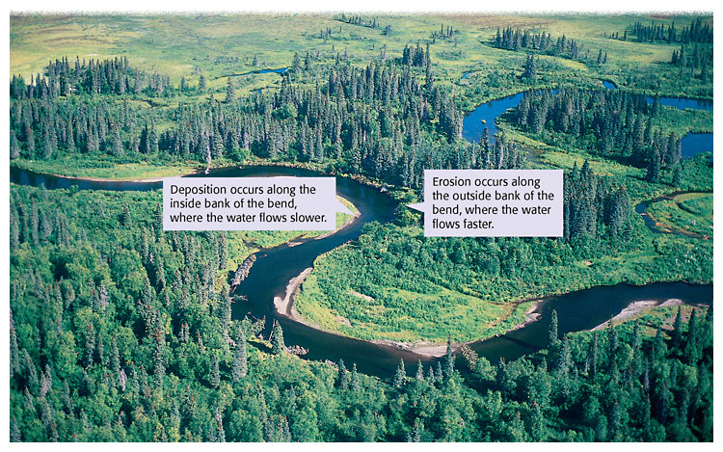
Rivers and streams deposit sediment where the speed of the water current decreases. Figure 1 shows this type of deposition.

Slide 8
Draw a picture of a river and make note of where the river is eroding and depositing simultaneously.

Slide 9
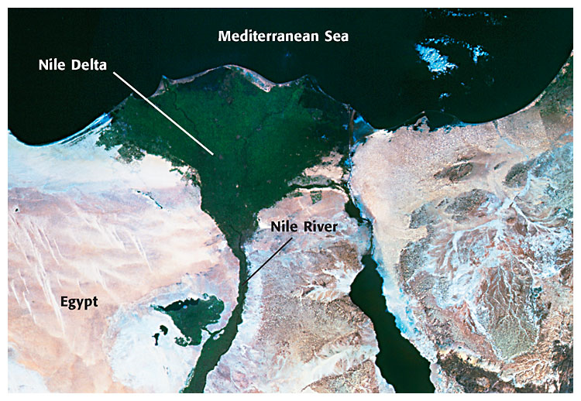
Tech Terms:
4. delta – a fan shaped depositional feature, formed when a load filled stream/river slows, as it enters a larger body of water.
As sediment is dropped at the mouth of the Nile River, in Egypt, a delta forms.

Slide 10
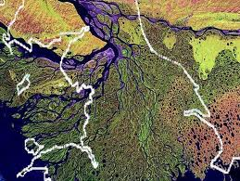
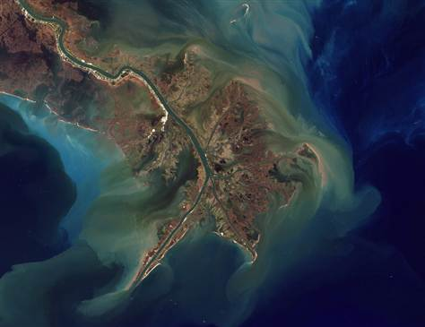

Slide 11
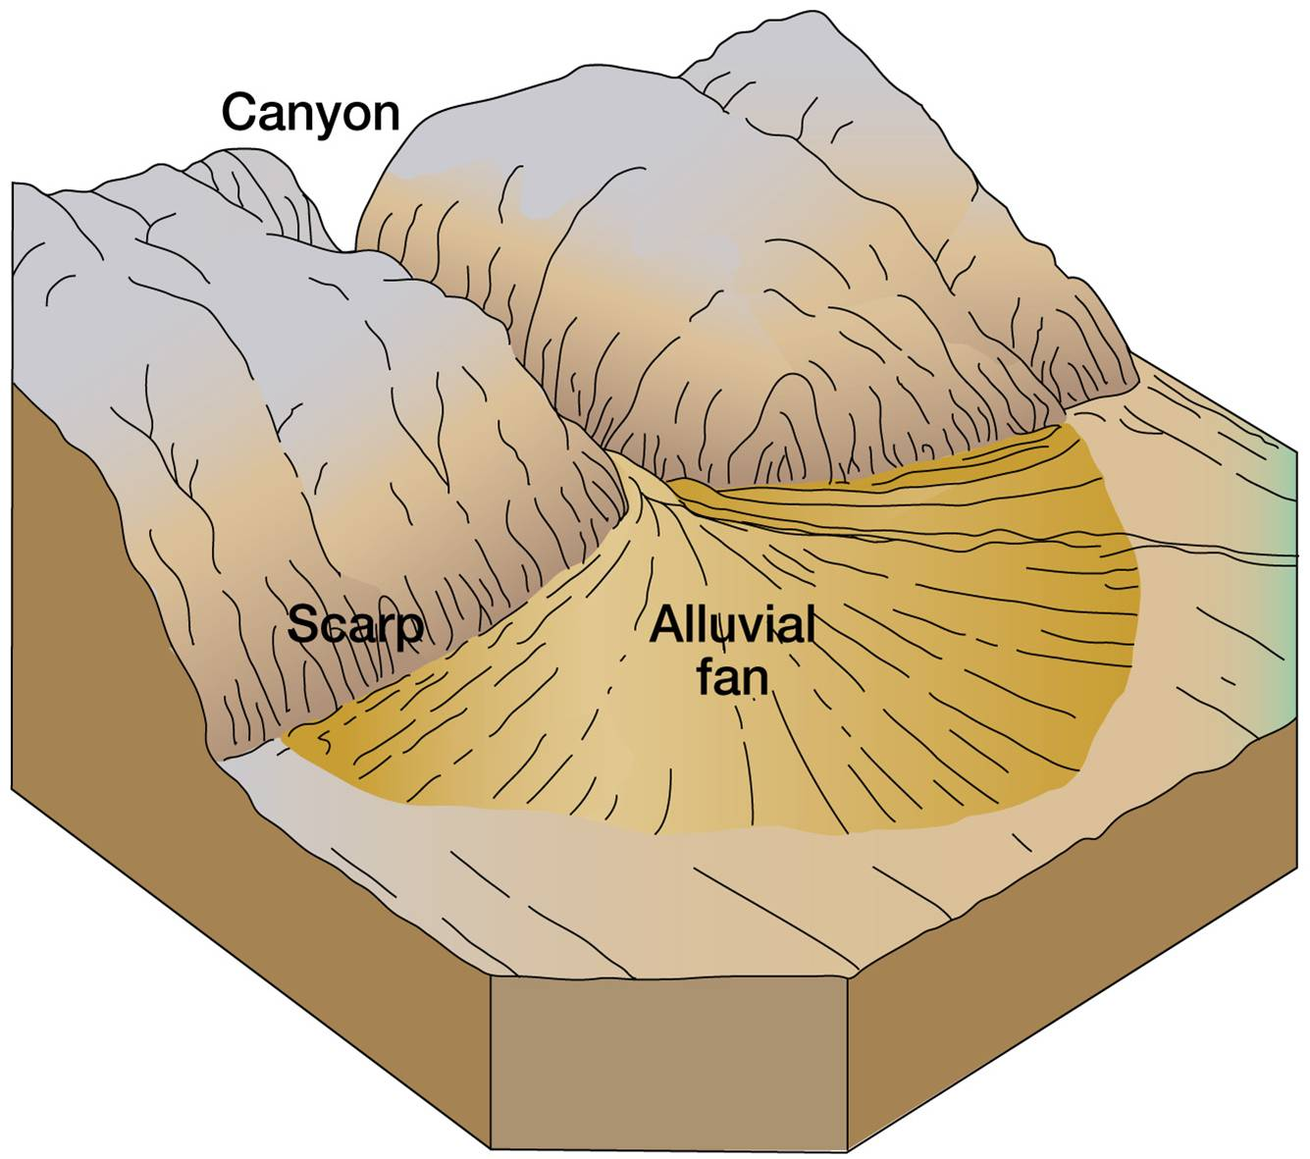
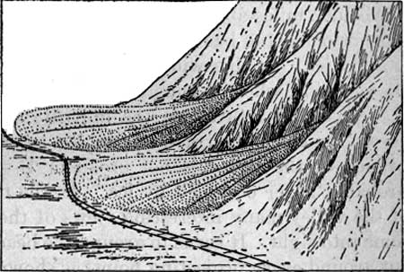
5. alluvial fan – a fan shaped depositional feature, formed when a fast moving mountain stream flows onto a flat plain.

Slide 12
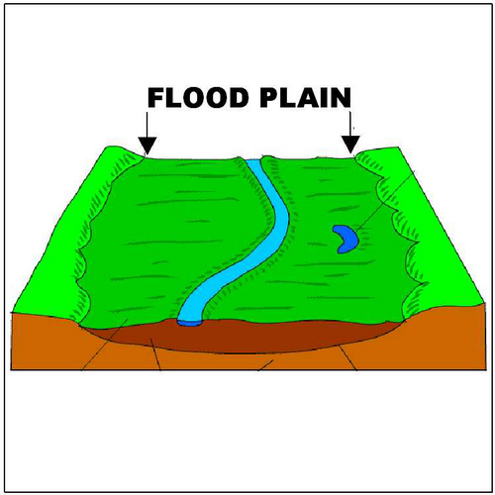
6. flood plain – the area along a river that contains rich, fertile soil due to periodic overflow from a stream/river.

Slide 13
Rivers brainpop

