Slide 1
13.2 The Ocean Floor
Objectives:
1. Identify the two major regions of the ocean floor.
2. Classify subdivisions and features of the two major regions of the ocean floor.

Slide 2
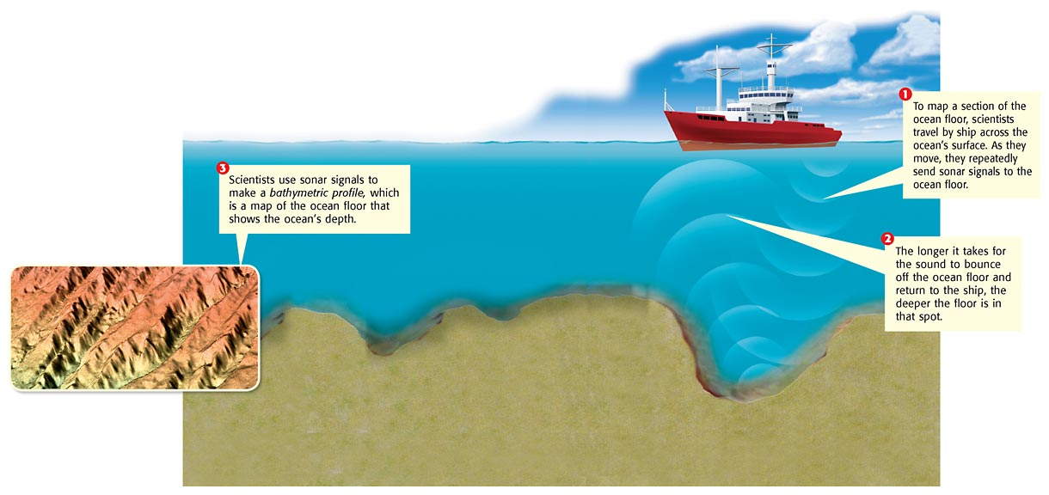
Studying the Ocean Floor
Seeing by Sonar: Scientists calculate the depth by multiplying half the travel time by the speed of sound in water (about 1,500 m/s).
Oceanography via Satellite
Studying the Floor with Geostat

Slide 3
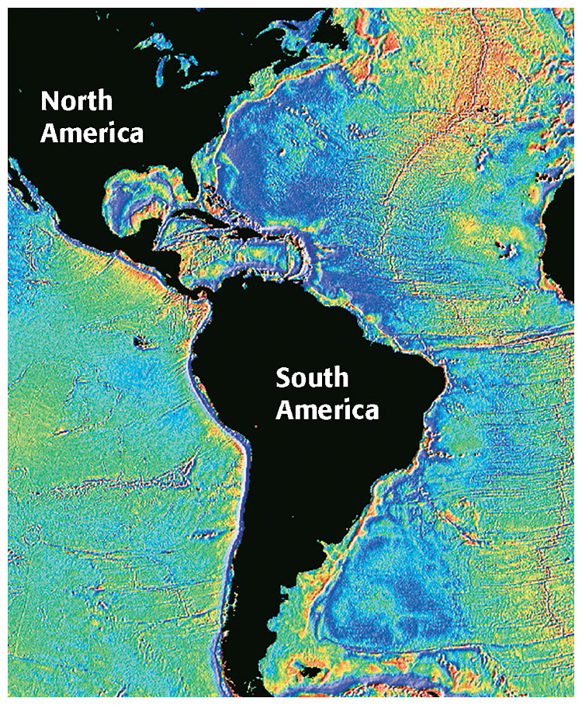
Geostat has been used to measure slight changes in the height of the ocean’s surface. Different underwater features, such as mountains and trenches, affect the height of the water above them.

Slide 4
Revealing the Ocean Floor
1. Continental margin – made of continental crust _____________
2. Deep ocean basin – made of oceanic crust
______________

Slide 5
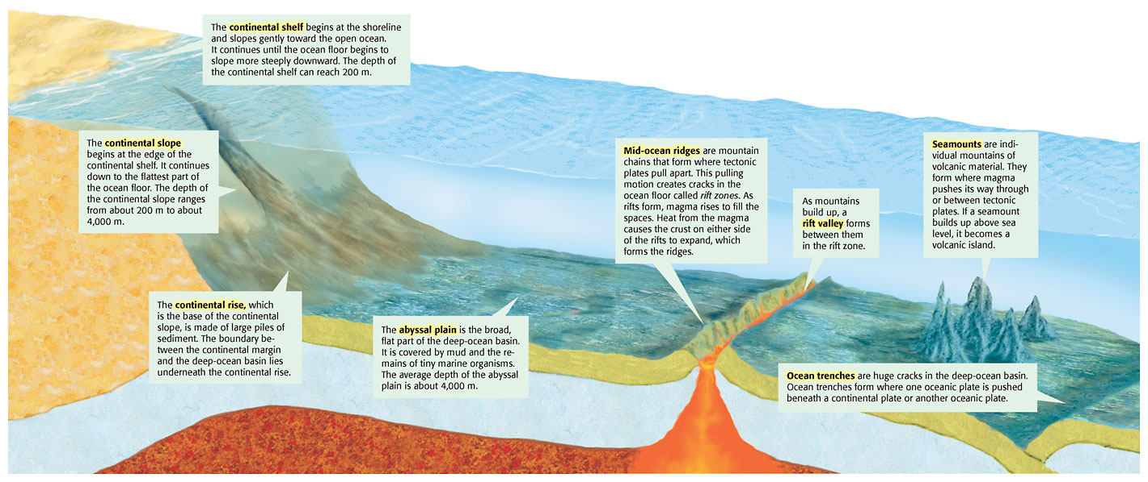

Slide 6
Ocean Floor Subdivisions and Features
Continental margin contains:
1. Continental shelf –
2. Continental slope –
3. Continental rise –

Slide 7
Ocean Floor Subdivisions and Features
Deep ocean basin contains:
Abyssal plain –
Mid-ocean ridges-
Rift valleys-
Trenches-

Slide 8
Technology Connection (enrichment)

