Slide 1
Let’s review more about minerals and crystals!
Bell Ringer:
Open your textbook to p. 69 and with your desk partner check answers 3-8 in your IAN. Remember complete sentences!
2) If you finish before your 5 minutes are up, you may open your book to p. 70-73 for today’s lesson & preview.

Slide 2
Review: How is a mineral different than a rock?
Rock | Mineral
Organic/inorganic | Inorganic
Inconsistent | Consistent crystal structure

Slide 3
Review:
SINC MNEMONICS
What 4 questions do you ask to test if something is a mineral?

Slide 4
*Please copy the purple info into your IAN!
Chap 3, Sect 2 (Identifying Minerals)
Objectives:
Identify 7 ways to determine the identity of minerals.
Explain some special properties of minerals.

Slide 5
Investigation!
Now Let’s give this a try as a whole team!
Take a look at the items in your tray. How would you classify them? Discuss as a team what groups they could be broken in to?

Slide 6
Tech Terms: (Copy the red words and purple definitions on to the peek-a-boo organizer in the blue tub/IAN)
luster– the way in which a mineral reflects light.
streak – the color of the powder of a mineral.

Slide 7
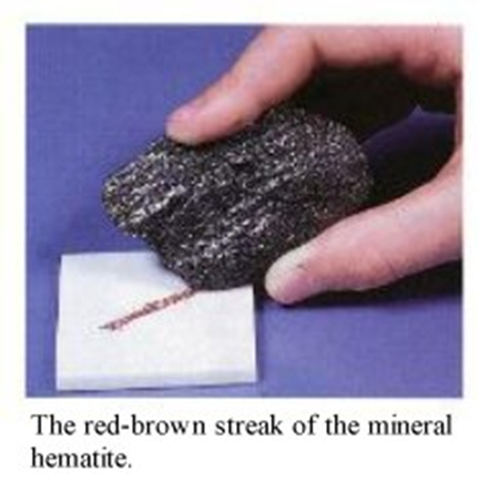

Slide 8
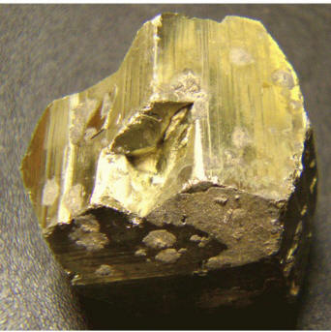
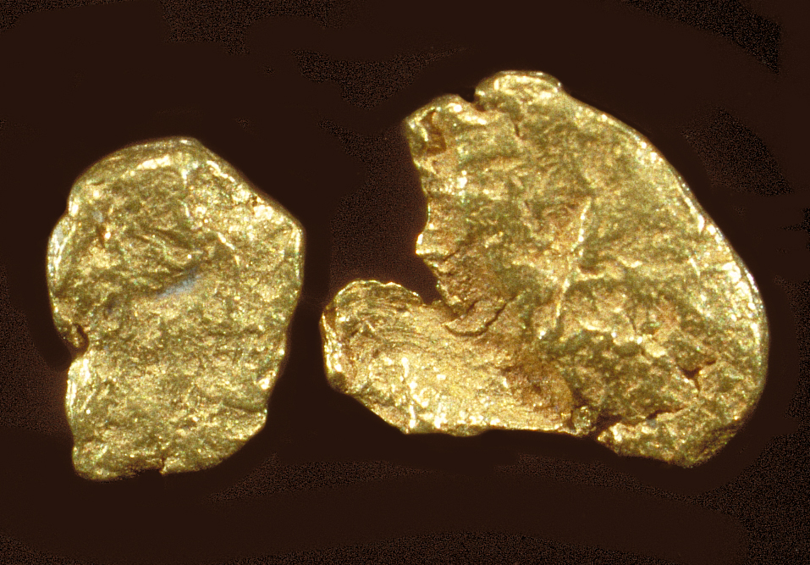
WHICH IS THE REAL THING?
Fools gold is usually iron pyrite or muscovite mica and can be easily tested by a streak test. (Gold will streak a bright yellow while pyrite will streak a blackish red).

Slide 9
3. cleavage – the tendency of a mineral to break along smooth, flat surfaces.
fracture – the tendency of some minerals to break unevenly along curved or irregular surfaces
Let’s look at the differences further!

Slide 10
Cleavage – A mineral that splits easily along flat surfaces has this property.
Mica separates easily in one direction forming flat sheets.
Feldspar splits at right angles, producing square corner.

Slide 11
Fracture – describes how a mineral looks when it breaks apart in an irregular way.
▪Quartz has a shell-shaped fracture. It produces curved shell-like surfaces that look like chipped glass.
▪Iron and copper have a hackly fracture (jagged points).
▪Clay has a earthy fracture.

Slide 12
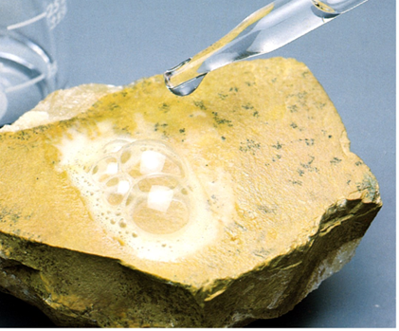
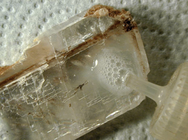
acid test – determines if a mineral contains calcium carbonate
(silicate or nonsilicate)
HCL acid, lemon juice

Slide 13
hardness – a measure of a mineral’s resistance to being scratched. Use Moh’s hardness scale. Look in book.
** What tools will we use to test this?
7. density – the measure of how much matter is in a given amount of space.

Slide 14
How to find density?
Size of the mineral may change but the density will always be the same.
To find the density, find the mass on the scale. Then drop the mineral in a graduated cylinder. The amount of water that rises (displacement) is the volume. Then divide the mass by the volume.

Slide 15
In Summary:
There are nearly 2,500 minerals that are known to occur within Earth’s crust. Only about 15 of those are common rock-forming minerals.
Minerals come in a variety of colors, so it is not the single best way to identify a mineral.
(real gold vs fools gold – pyrite)
(many colors of quartz!)

Slide 16
Special Properties
Minerals that glow under ultraviolet light have a property known as fluorescence.
Magnetite –natural magnet.
Uraninite –radioactive
Calcite –reacts with acid.
Quartz –produces a small electric current. It is used in microphone, radio transmitters, watches.

Slide 17
One Last Time….

Slide 18
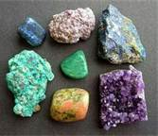
Color
CC
COLOR- NO
Record the color or colors you see
in the mineral.

Slide 19
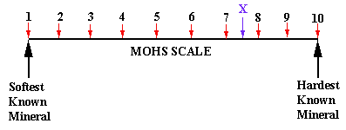
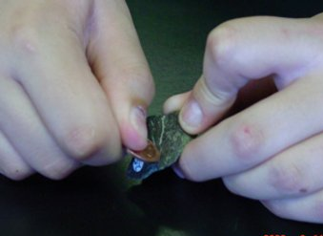
HARDNESS
You will perform a set of tests to determine the hardness of your mineral. Then write the number from the Moh’s Scale (1-10) on your recording sheet.
1-2 can be scratched with your fingernail.
3-4 can be scratched with a penny.
5-6 can be scratched with a nail.
7-8 scratches the glass plate.

Slide 20
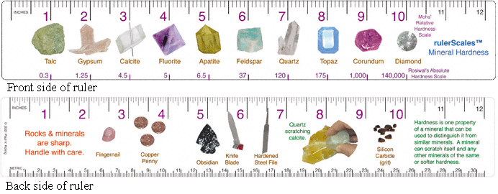

Slide 21
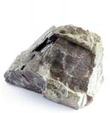
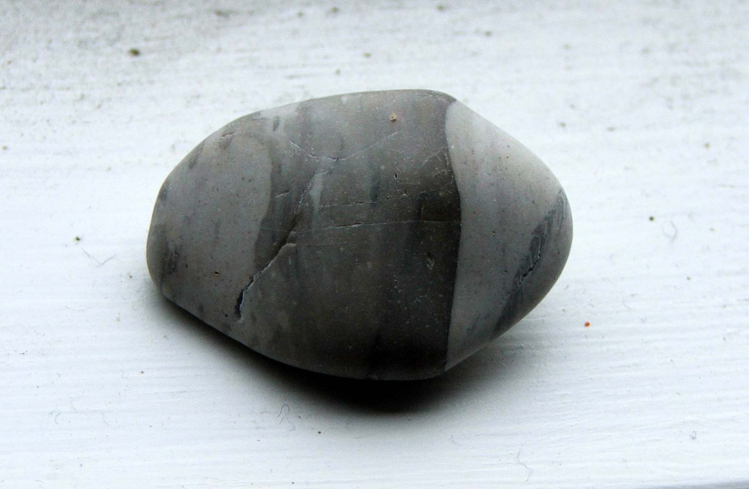
Texture
How does your mineral feel?
Write one of the words:
  Smooth Bumpy
  Rough Jagged

Slide 22
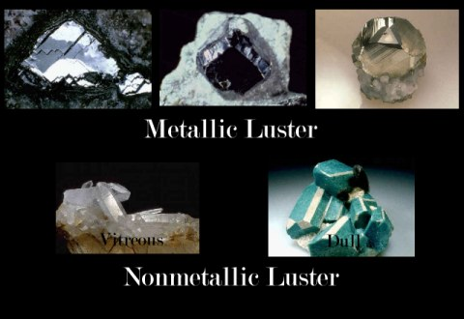
LUSTER
Is your mineral shiny or dull?

Slide 23
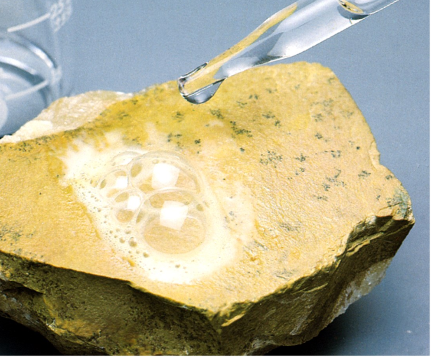
Acid Test: REACTS WITH VINEGAR
1^{st-} put a pair of goggles on.
2nd- using the pipette ONE person put 3 drops of vinegar on your mineral.
3rd- use a magnifying glass to see if a reaction occurred. Look for bubbles or fizzing.

Slide 24

STREAK TEST
Scratch the mineral ONCE on the tile to
find the streak color. Write the color on your recording sheet.

Slide 25
Enrichment:
Read 3.2, and provide 1 example each of today’s vocabulary.

