Slide 1
13.2 The Ocean Floor
Objectives:
1. Identify the two major regions of the ocean floor.
2. Classify subdivisions and features of the two major regions of the ocean floor.

Slide 2
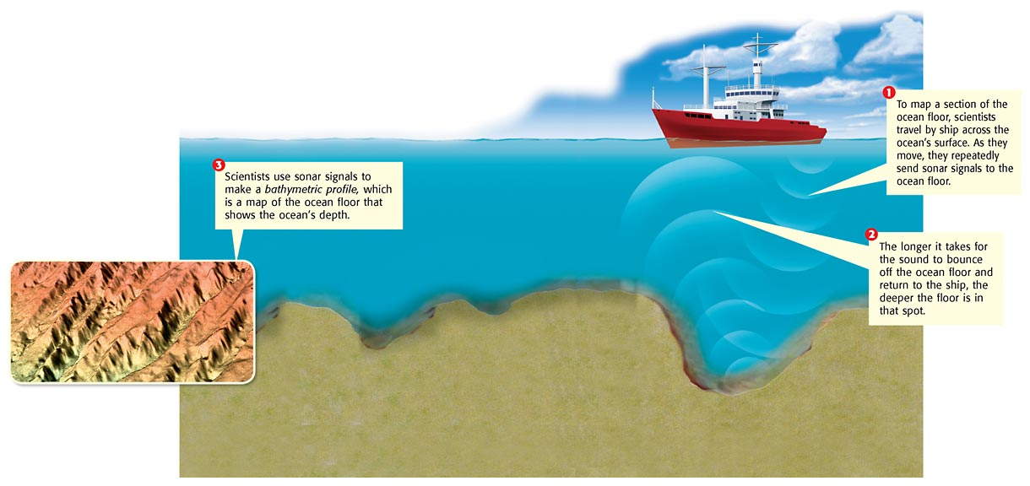
Studying the Ocean Floor
Seeing by Sonar: Scientists calculate the depth by multiplying half the travel time by the speed of sound in water (about 1,500 m/s).
Oceanography via Satellite
Studying the Floor with Geostat

Slide 3
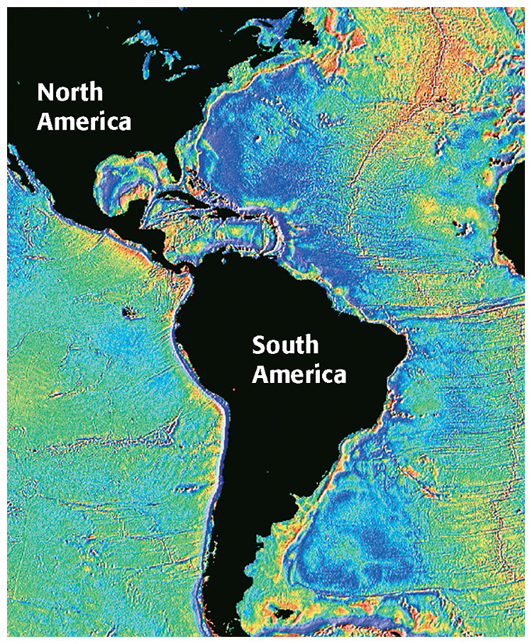
Geostat has been used to measure slight changes in the height of the ocean’s surface. Different underwater features, such as mountains and trenches, affect the height of the water above them.

Slide 4
Revealing the Ocean Floor
Continental margin – made of continental crust (GRANITE)
Like the shallow end of the pool.
Deep ocean basin – made of oceanic crust
(BASALT)
Like the deep end of the pool.

Slide 5
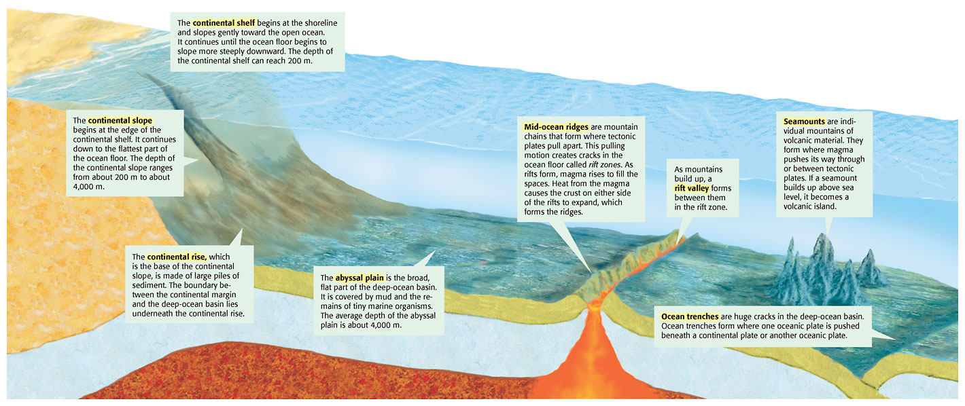

Slide 6
Ocean Floor Subdivisions and Features
Continental margin contains:
1. Continental shelf – The gently sloping section of the continental margin (located between the shoreline and the continental slope)
2. Continental slope – Located between the continental rise and the continental shelf.
3. Continental rise – Located at the base of the continental slope and made up of large piles of sediment.

Slide 7
Ocean Floor Subdivisions and Features
Deep ocean basin contains:
Abyssal plain – A large, flat, almost level area of the deep ocean basin
Mid-ocean ridges- A long, undersea mountain chain that forms along the floor of major oceans.
Rift valleys- A long narrow valley that forms as tectonic plates separate (diverge)
Trenches- A steep, long depression in the deep-sea floor that runs parallel to a chain of volcanic islands or a continental margin

Slide 8
Technology Connection (enrichment)

