Slide 1
Chapter 4
Rocks: Mineral Mixtures
Chap 4, Sect 4 (Metamorphic Rock)
Objectives:
Describe two ways a rock can undergo metamorphism.
Describe the difference between foliated and non-foliated metamorphic rock.

Slide 2
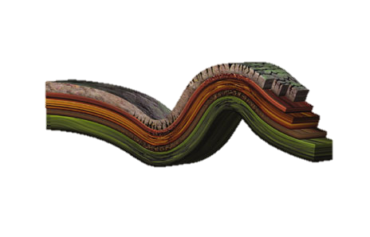
2 Ways Metamorphic Rock Forms:
Metamorphic Rock Classifications
Contact
Regional
Notes:
i

Slide 3
Tech Terms:
Types of metamorphism
Contact – 2. Regional -
occurs near an rocks that
igneous intrusion experience
when the change caused
surrounding rock is by pressure
heated to VERY high deep below or
temperatures (creates collision with non-foliated texture) other rock formations.
(creates foliated texture)

Slide 4
2 Types of texture (how it feels)
foliated – mineral grains are flat and aligned in planes or bands (gneiss).
4. nonfoliated – mineral grains may change in size or composition (marble).

Slide 5
2 geological processes form
metamorphic rocks
(draw them below)
Heat
Pressure

