Slide 1
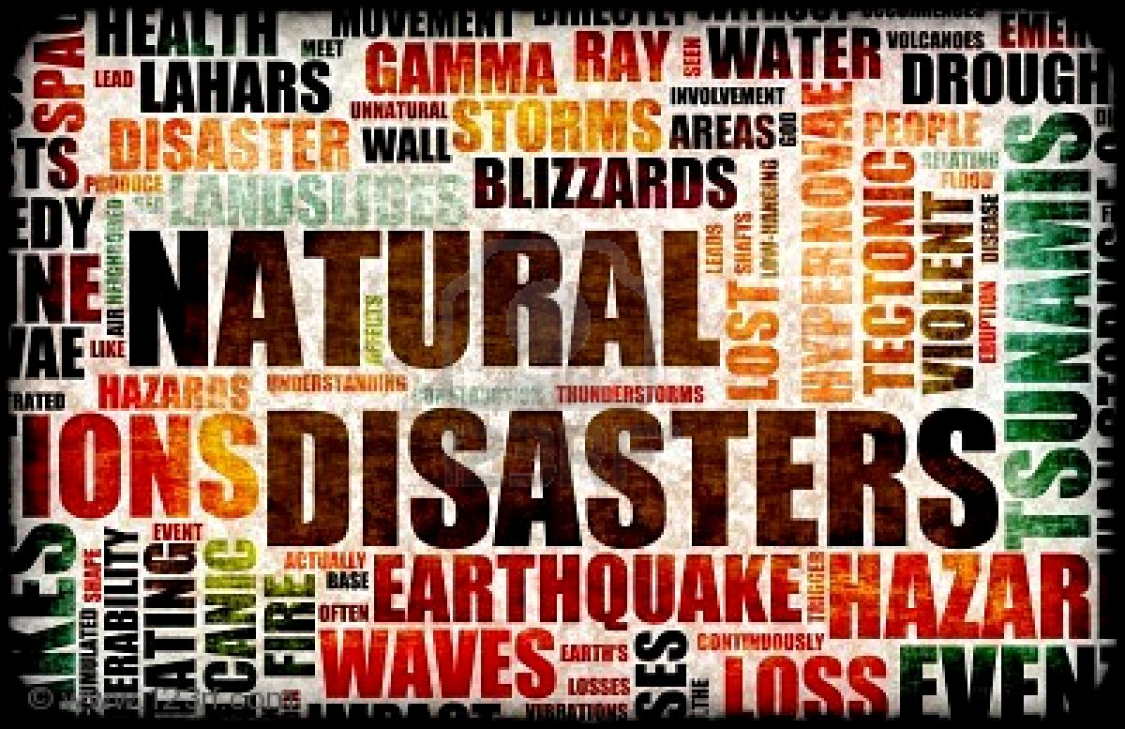

Slide 2
Shark Tank Intro Music!
CNN Current Day Natural Disasters:
Droughts, Earthquakes, Hurricanes, how many more?
Are you up to the challenge?
What resources and skill sets do you have to offer?
A farmer's shark tank focuses on cause/effect/solutions!

Slide 3
Skills for the 21st Century
Creativity and Innovation
Critical Thinking and Problem Solving
Communication and Collaboration
Global Awareness
Initiative and Self-Direction
Flexibility and Adaptability
Effective Interaction with Others

Slide 4
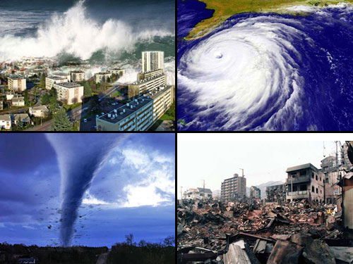
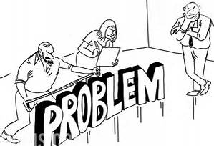
What is the problem?
There are many natural disasters happening all around the world. Many people are not prepared to face these disasters. Your team will be creating an emergency plan to help people recover from natural disasters.
You will also create an invention that might help people that are in the disaster or feeling the effects after the disaster.
****Sometimes it is not the actual disaster that causes the worst problems….it is what happens next.***

Slide 5
Science
As a team, you will go through the STEM engineering process. You will design, engineer, and innovate your product. You will classify the level of your survival prototype.
You will create a real world solution/innovation to SURVIVE your natural disaster. This invention will be presented to our SURVIVAL Shark Tank by either a tri-fold or PowerPoint presentation.

Slide 6
How does this apply to my life now or to my future in the real world?
How does this demonstrate innovation?
How does this demonstrate problem solving?
How does this connect to MUSIC?
How does this connect to PE/HEALTH?
How does this connect to SOCIAL STUDIES?
ST EM LEN S
How does this connect to ART?
How does this connect to READING?
How does this connect to my CONNECTIONS CLASSES?
How does this connect to LANGUAGE ARTS?
How does this connect to MATH?
How does this connect to SCIENCE?

Slide 7
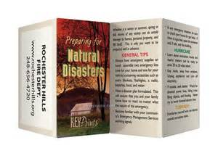
Language Arts
AC ELA students will read an article on their chosen topic: tornado, hurricane, tsunami, and/or earthquake. (Do you have any suggestions on articles?)
AC ELA: Students will also compose a letter/persuasive proposal that focuses on soliciting a manufacturer to produce the prototype or a company known in the marketplace for producing survival equipment.
In OL language arts, you will create brochures based on different disasters explaining what types of supplies people should have prior to an emergency. You will also learn about the causes and the effects of these disasters to include in your brochure.

Slide 8
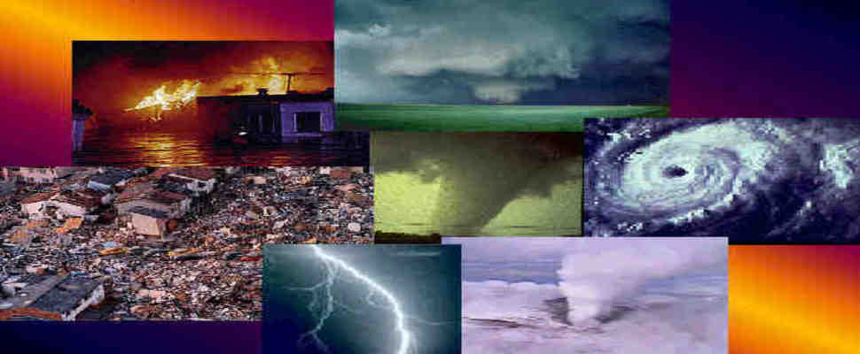
Reading
In reading, you will learn about natural disasters and severe weather through your Scholastic News magazine. This will prepare you to work on this STEM project.

Slide 9
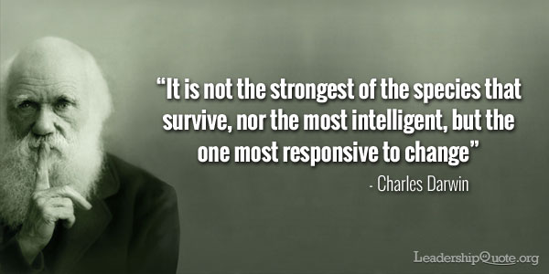
Social Studies
In your class, you will begin researching the impacts of real world disasters that you have learned about on CNN Student News this year.
Financial
Social
Geographical

Slide 10
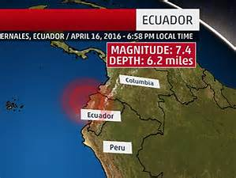
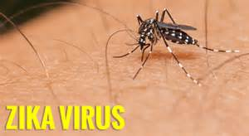
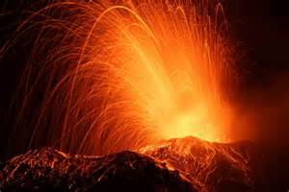
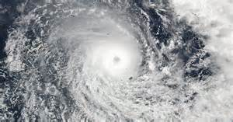
Topics
Earthquake in Chile, Fiji, or Italy
Flooding in Australia (cyclone Debbie)
Drought in Australia or CA
Zika virus in Brazil
Tornadoes in GA or OK
Wild Fires in Gatlinburg
Cyclone in Fiji
Hurricane in Costa Rica

Slide 11
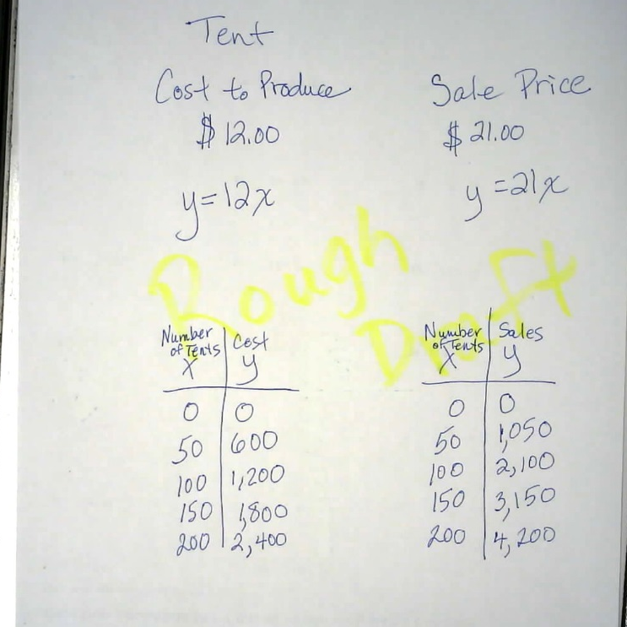
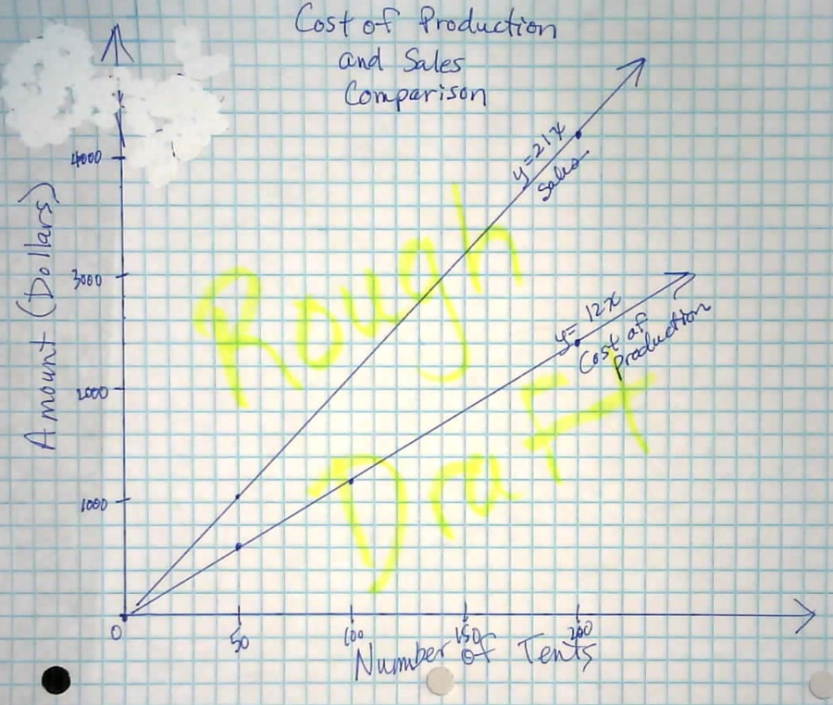
Math
You will determine the cost to build your actual invention and the cost to market your invention.
You will also determine how much you want to charge for your product.

Slide 12
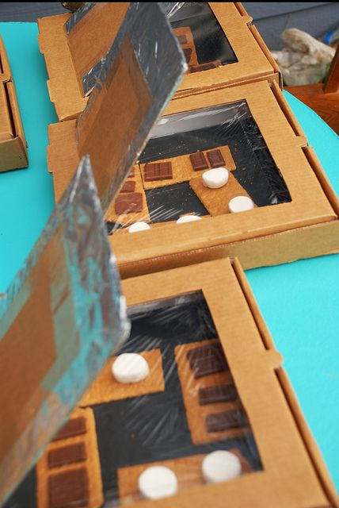
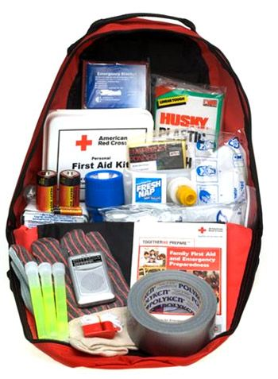
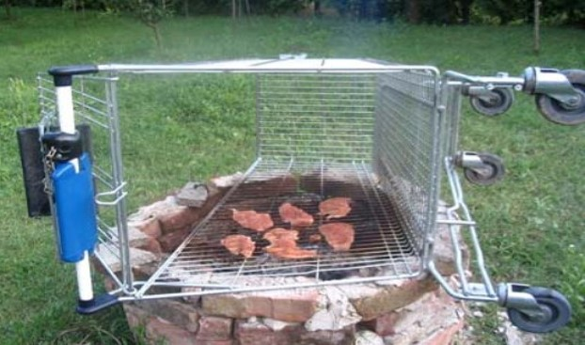
EXAMPLES

Slide 13
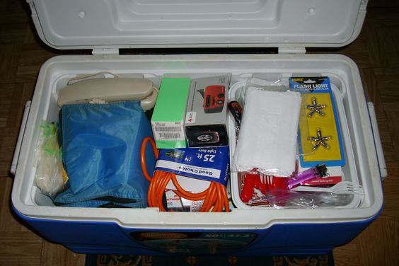
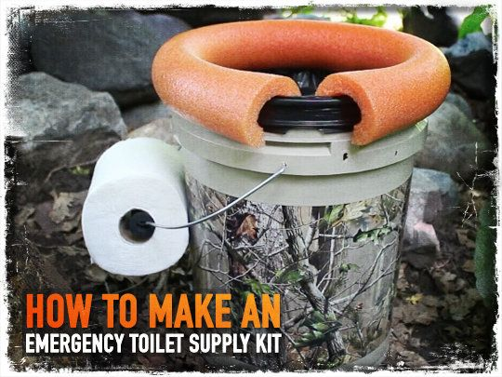
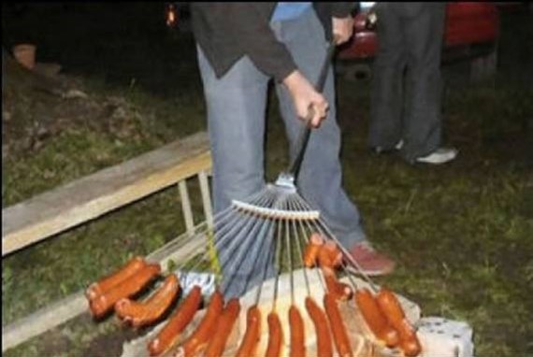
EXAMPLES

Slide 14
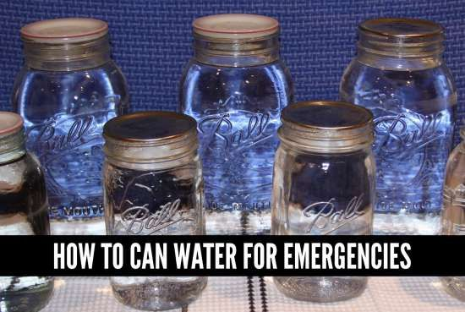
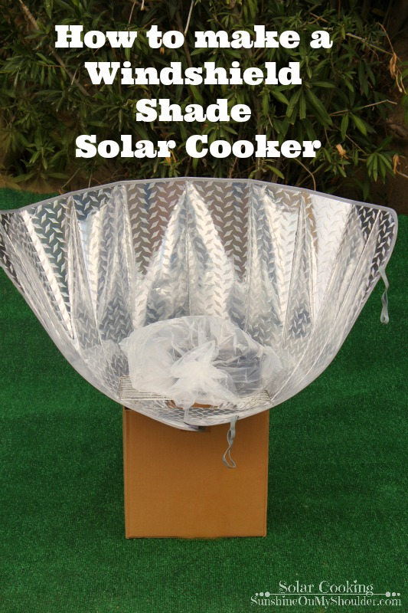
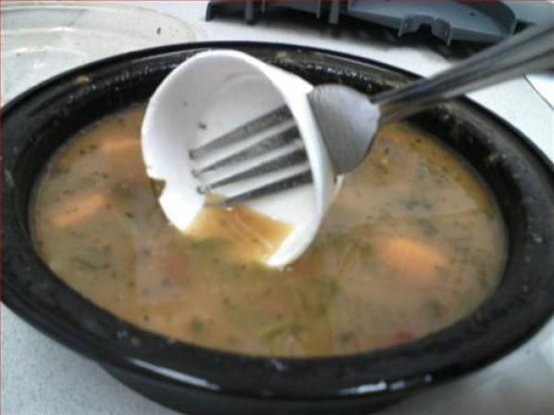
EXAMPLES

Slide 15
STEM Process
Ask | Imagine
Identify / Research the problem Determine design constraints Consider relevant prior knowledge | Brainstorm design ideas Draw and label those ideas
Plan | Create
Pick one idea Draw and label the idea Identify needed materials or conditions for prototype | Carry out the plan Create the design Test the design
Improve
Reflect on testing results Plan for, create and test a new (improved) design

Slide 17
Skills for the 21st Century
Creativity and Innovation
Critical Thinking and Problem Solving
Communication and Collaboration
Global Awareness
Initiative and Self-Direction
Flexibility and Adaptability
Effective Interaction with Others

Slide 18
