Slide 1
Let’s Review!!!

Slide 2
The Water Cycle

Slide 3
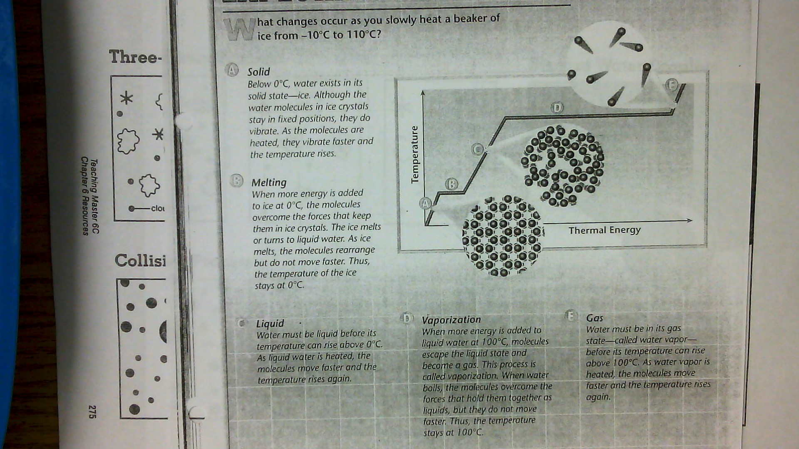

Slide 4
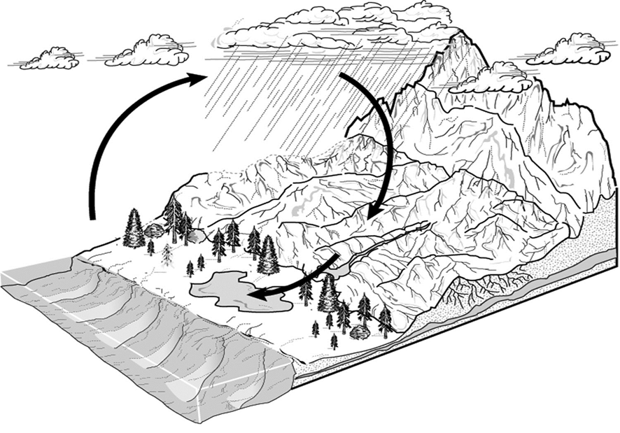
Name that VERB!

Slide 5
Verb vs. Noun

Slide 7
Sticky Water??
When water vapor begins to condense, or turn change from a gas, back into a liquid, the droplets start out small.
Because of their “cohesive” (like molecules are attracted and stick together) or sticky qualities, they like to attach to each other and get much larger.
Because of “adhesion” (unlike molecules are attracted and stick together) other things like dust and pollution, stick to the liquid droplets!

Slide 8
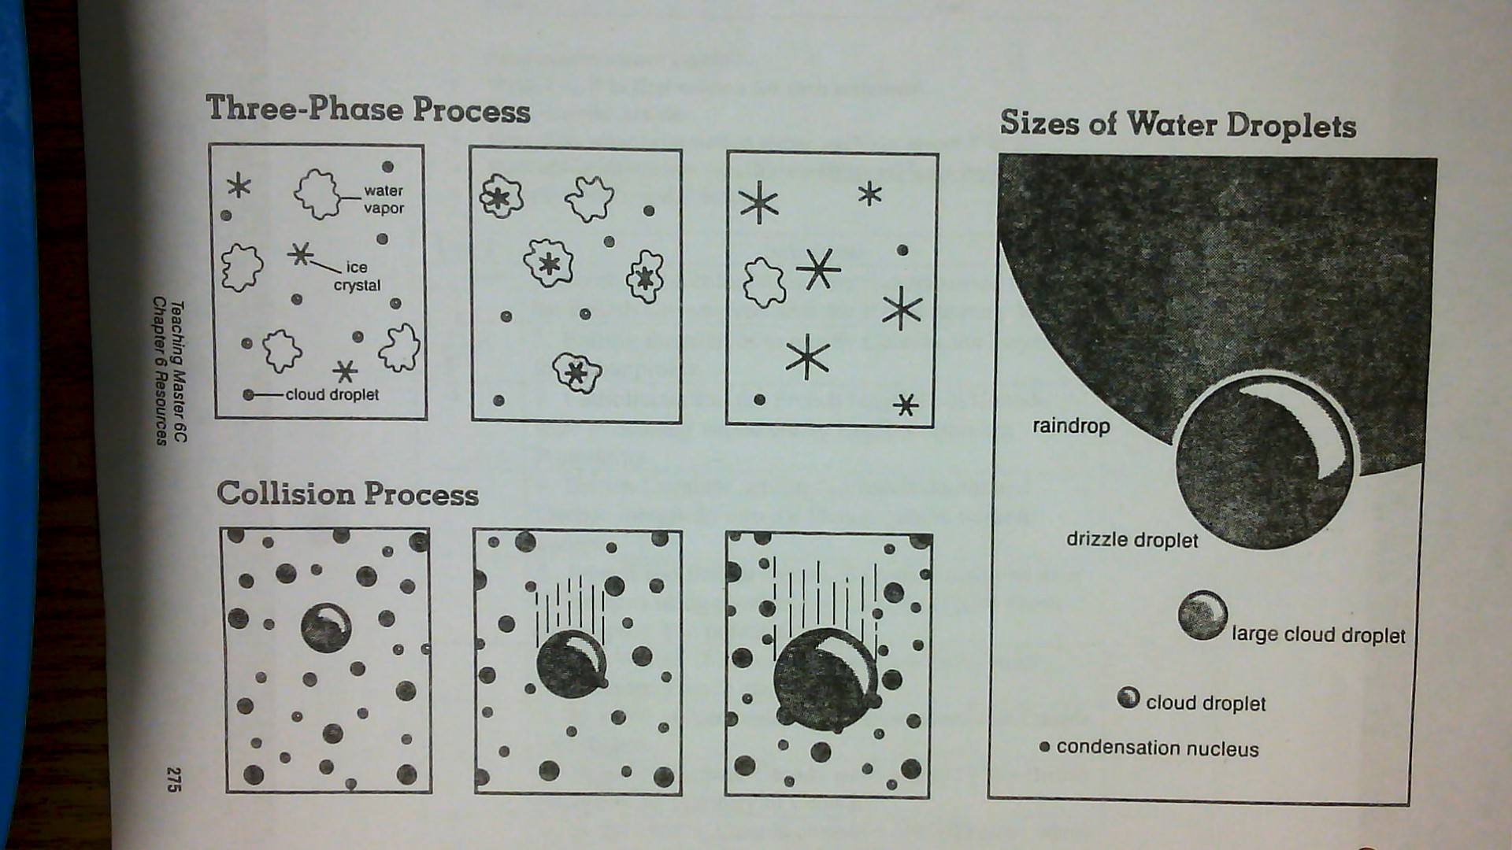

Slide 9
Fresh Water Underground
The water table rises during wet seasons and falls during dry seasons.
In this zone, the spaces between the rock particles are filled with water.

Slide 10
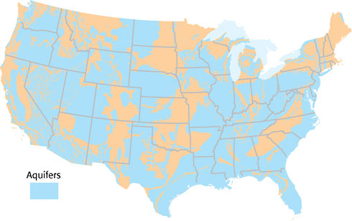
Aquifers
The best aquifers usually form in permeable materials, such as sandstone, limestone, or layers of sand and gravel. Some aquifers cover large underground areas and are an important source of water for cities and agriculture. The map in Figure 3 shows the location of the major aquifers in the United States. Is GA a natural aquifer?
The ground surface where water enters an aquifer is called the recharge zone. The size of the recharge zone depends on how permeable rock is at the surface.

Slide 11
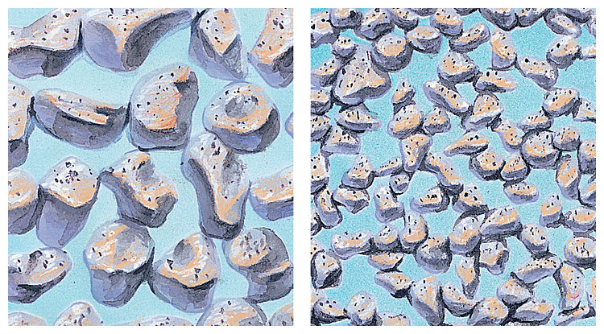
Porosity:
The more open spaces, or pores, between particles in an aquifer, the more water the aquifer can hold.
The percentage of open space between individual rock particles in a rock layer is called porosity.
Permeability:
If the pores of a rock layer are connected, groundwater can flow through the rock layer.
A rock’s ability to let water pass through is called permeability.
A rock that stops the flow of water is impermeable.
Large particles, shown at left, have less total surface area—and cause less friction—than small particles, shown at right, do.

Slide 12
In the drawing, label the water table, saturated zone, and unsaturated zone. Color the saturated zone blue and the unsaturated zone brown.

Slide 13
Water Pollution
Point-Source Pollution:
Pollution that comes from one specific site
Ex. A leak from a sewer pipe, oil tanker spill
can be controlled because its source can be identified. Nonpoint-source pollution:
comes from many sources
much more difficult to control because it does not come from a single source.
Most nonpoint-source pollution reaches bodies of water by runoff.
Ex. street gutters, fertilizers, eroded soils and silt from farming and logging, drainage from mines, and salts from irrigation

Slide 14
In Summary:
Which materials in the classroom would be considered permeable? Why?
The process by which leaves give off water into the atmosphere is called
What is the continuous movement of water through Earth’s environment called?

Slide 15
True or False: Icebergs are formed from frozen salt water.
What variable must change to cause water to either evaporate or condense? Give an example!

