Slide 1
Bell Ringer: Open your Ian and glue in yesterday’s anticipation guide! Cut and trim. Open your books to Oceans…
Ch.13. Section 1

Slide 2
Objectives: *List the major divisions of the global ocean. *Identify the properties of ocean water. *Describe the interactions between the ocean and the atmosphere (water cycle).

Slide 3
Divisions of the Global Ocean: 376 million sq km.
Pacific Ocean – largest
Atlantic Ocean
Indian Ocean
Southern Ocean
5.Arctic Ocean – smallest
**Beaker Models

Slide 4
How Oceans Formed E Activity: How Oceans Formed
About 4.5 billion years ago, Earth was a very different place. There were no oceans.
The volcanic gases began to form Earth’s atmosphere. Meanwhile, Earth was cooling.
Earth cooled enough for water vapor to condense. This water began to fall as rain.
The rain filled the deeper levels of Earth’s surface, and the first oceans began to form.

Slide 6
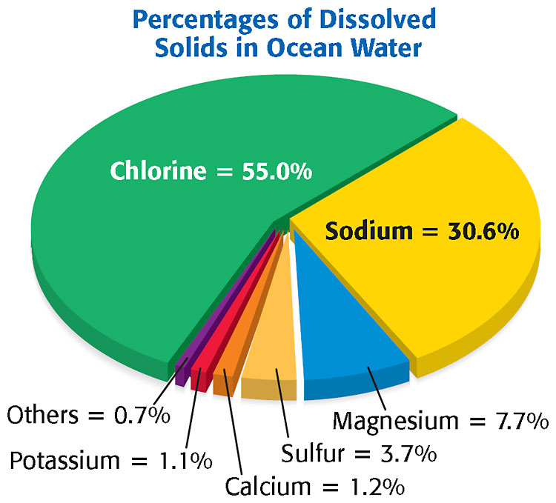
Ocean Water Properties / Characteristics
It is SALTY
WHY? Rivers and streams flow, carrying dissolved minerals from surrounding rocks and soil.
At the same time, water evaporates from the ocean leaving the dissolved solids (NaCl – sodium chloride) behind.

Slide 7
Ocean Water Properties / Characteristics
Has a high SALINITY –
a measure of the amount of dissolved salts or solids in a liquid.
The Ocean CLIMATE affects salinity
hotter/drier coastal water has a higher evaporation rate, thus higher salinity
cooler/humid coastal water has a lower evaporation rate, thus lower salinity
(FLORIDA vs MAINE)

Slide 8
The Water MOVEMENT affects salinity
faster moving water develops low salinity areas
(ex. Mississippi enters into the Gulf)
2.slower moving water develops high salinity areas
(ex. Mediterranean Sea)

Slide 9
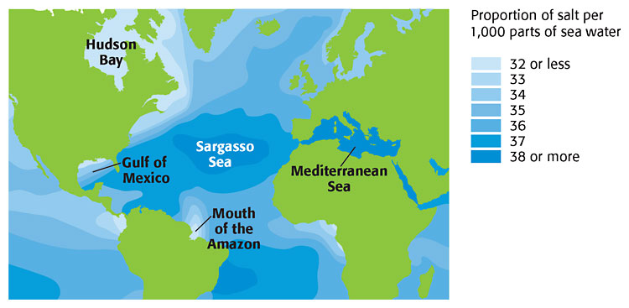
Ocean Water Properties / Characteristics
TEMPERATURE of ocean water decreases
as DEPTH increases

Slide 10
Let’s Review:
Between which two steps of the water cycle does the ocean fit?
Identifying Relationships; List one factor that affects salinity in the ocean. Explain how each factor affects salinity or temperature.
Brainpop Oceans

Slide 11
TEMPERATURE of ocean water decreases
as DEPTH increases
E Activity:
Factors that Affect Ocean Salinity

Slide 12
Ocean is a Global Thermostat
The ocean absorbs and holds energy from sunlight. This regulates atmospheric temperatures.
If the ocean did not release thermal energy so slowly, the air temperature on land would vary greatly (over 200˚ F to -200˚F)

Slide 13
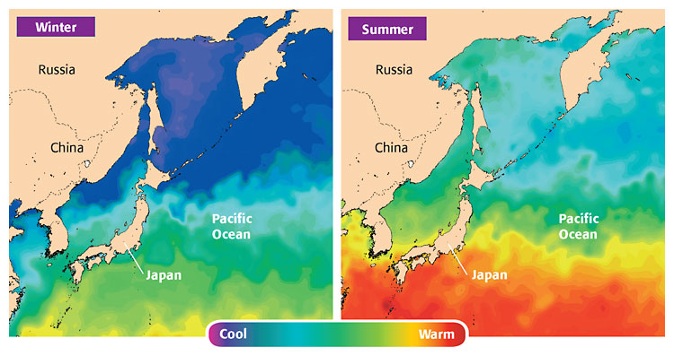

Slide 14
In Summary:
The global ocean is divided by the continents into five main oceans: _____________________________________________________.
The five oceans as we know them today formed within the last _________years.
Salts have been added to the ocean for billions of years. _____________ is a measure of the amount of dissolved salts in a given weight or mass of liquid.
The three temperature zones of ocean water are the surface zone, the thermocline, and the ______________.
The _________________is the continuous movement of water from the ocean to the atmosphere to the land and back to the ocean. The ocean plays the largest role in the water cycle.
The ocean stabilizes Earth’s weather conditions by absorbing and holding ________________ energy.
Why is the ocean salty? Because fish don’t like pepper!

